Slide 1
Multi-Tenant Application Using Spring Boot

Slide 2
What is Multi-Tenant Application
A single instance of a software application serves multiple customers. Each customer is called a tenant.
Tenants can be given the ability to customize some parts of the application.
In a multi-tenant architecture, multiple instances of an application operate in a shared environment.
To develop multi tenant application ,select the database at runtime based on the user. So it need to maintain one web server (i.e. tomcat) and N databases only.

Slide 3
Types of multi-tenant architecture
1. Single application, single database.
A single, shared database schema is a multi-tenancy model with a multi-tenant database
This is the simplest form out of the three model types
Relatively low cost for tenants because of the use of shared resources.
This form uses a single application and database instance to host multiple simultaneous tenants and store data.

Slide 4
2.Single application, multiple database
This multi-tenant architecture includes the use of a single database with multiple schemas.
This tenant system uses a single application instance with individual databases for each tenant.
In addition, this architecture is more difficult to scale and has a higher cost and more overhead with each database.

Slide 5
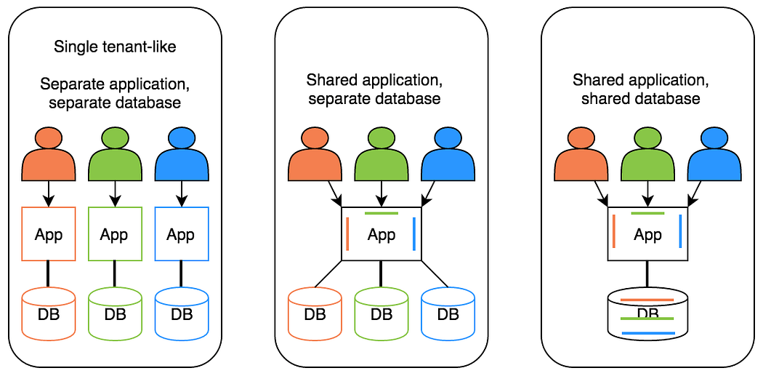
3.Multiple application, multiple database.
This type of multi-tenant architecture hosts data in multiple databases.
This model is relatively complex in terms of cost, management and maintenance, but the approach is secure, and tenants can be separated by a chosen criterion.

Slide 6
Microservices in a Multi-Tenant Application
The concept of microservices can be used to modularize and separate different functionalities, allowing for better scalability, maintainability etc.
1. Authentication Microservice
Handles user authentication and authorization across all tenants.
It provides a centralized mechanism for user login, token generation, and access control.
This microservice ensures that tenant-specific data and resources are securely accessed by authorized users.

Slide 7
2.Tenant Management Microservice
The tenant management microservice is responsible for tenant provisioning, configuration etc.
It handles tasks such as creating new tenants, managing tenant-specific configurations, and handling tenant subscriptions and billing.
3.Tenant-Specific Services
These microservices are specific to each tenant and provide functionality .
This represent the core business logic or features of the application that are specific to individual tenants.

Slide 8
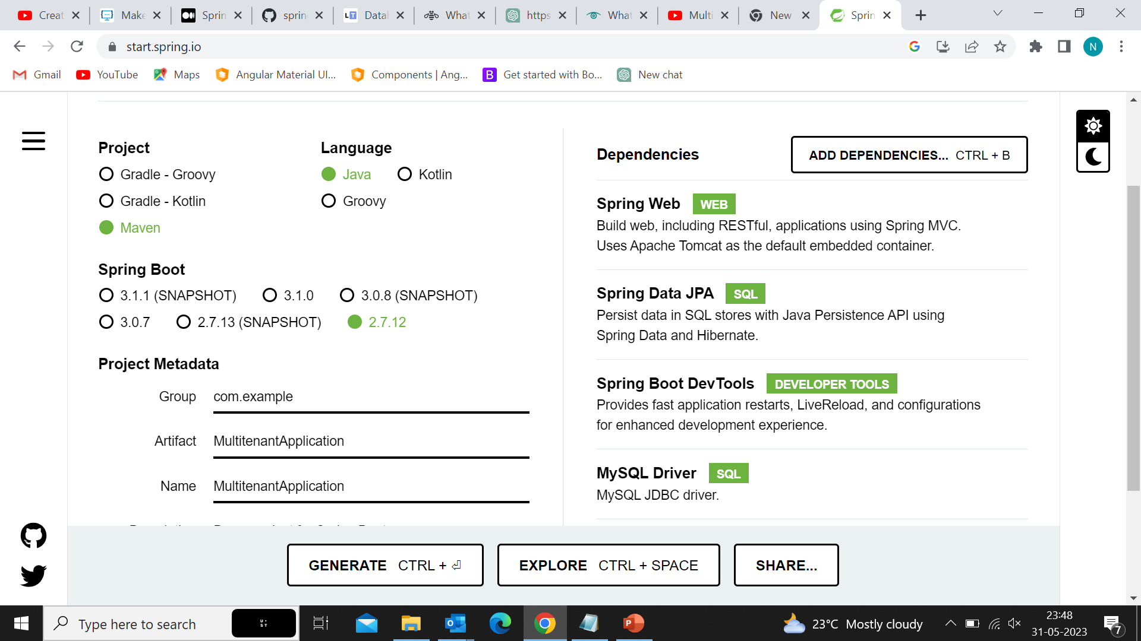

Slide 9
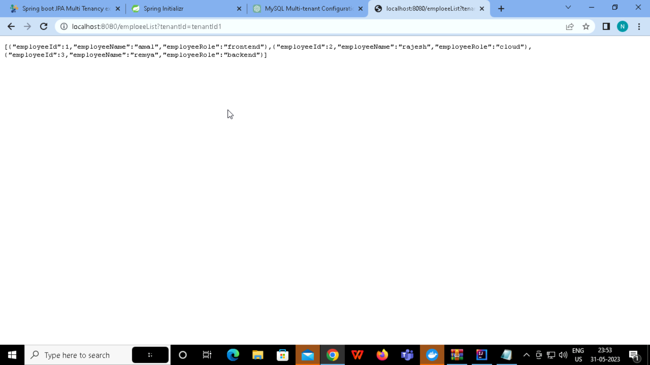

Slide 10


Slide 11
Reference
https://github.com/nimisha173/Multitenant-Application
https://javadeveloperzone.com/spring-boot/spring-boot-jpa-multi-tenancy-example/

